Slide 1
Habitats: Biotic and abiotic factors

Slide 2
Definitions
Habitat | The place where an animal, plant or other organism lives.
Ecosystem | A community of interacting organisms and their environment.
Ecology | The study of how living things interact with each other and their environment.

Slide 3
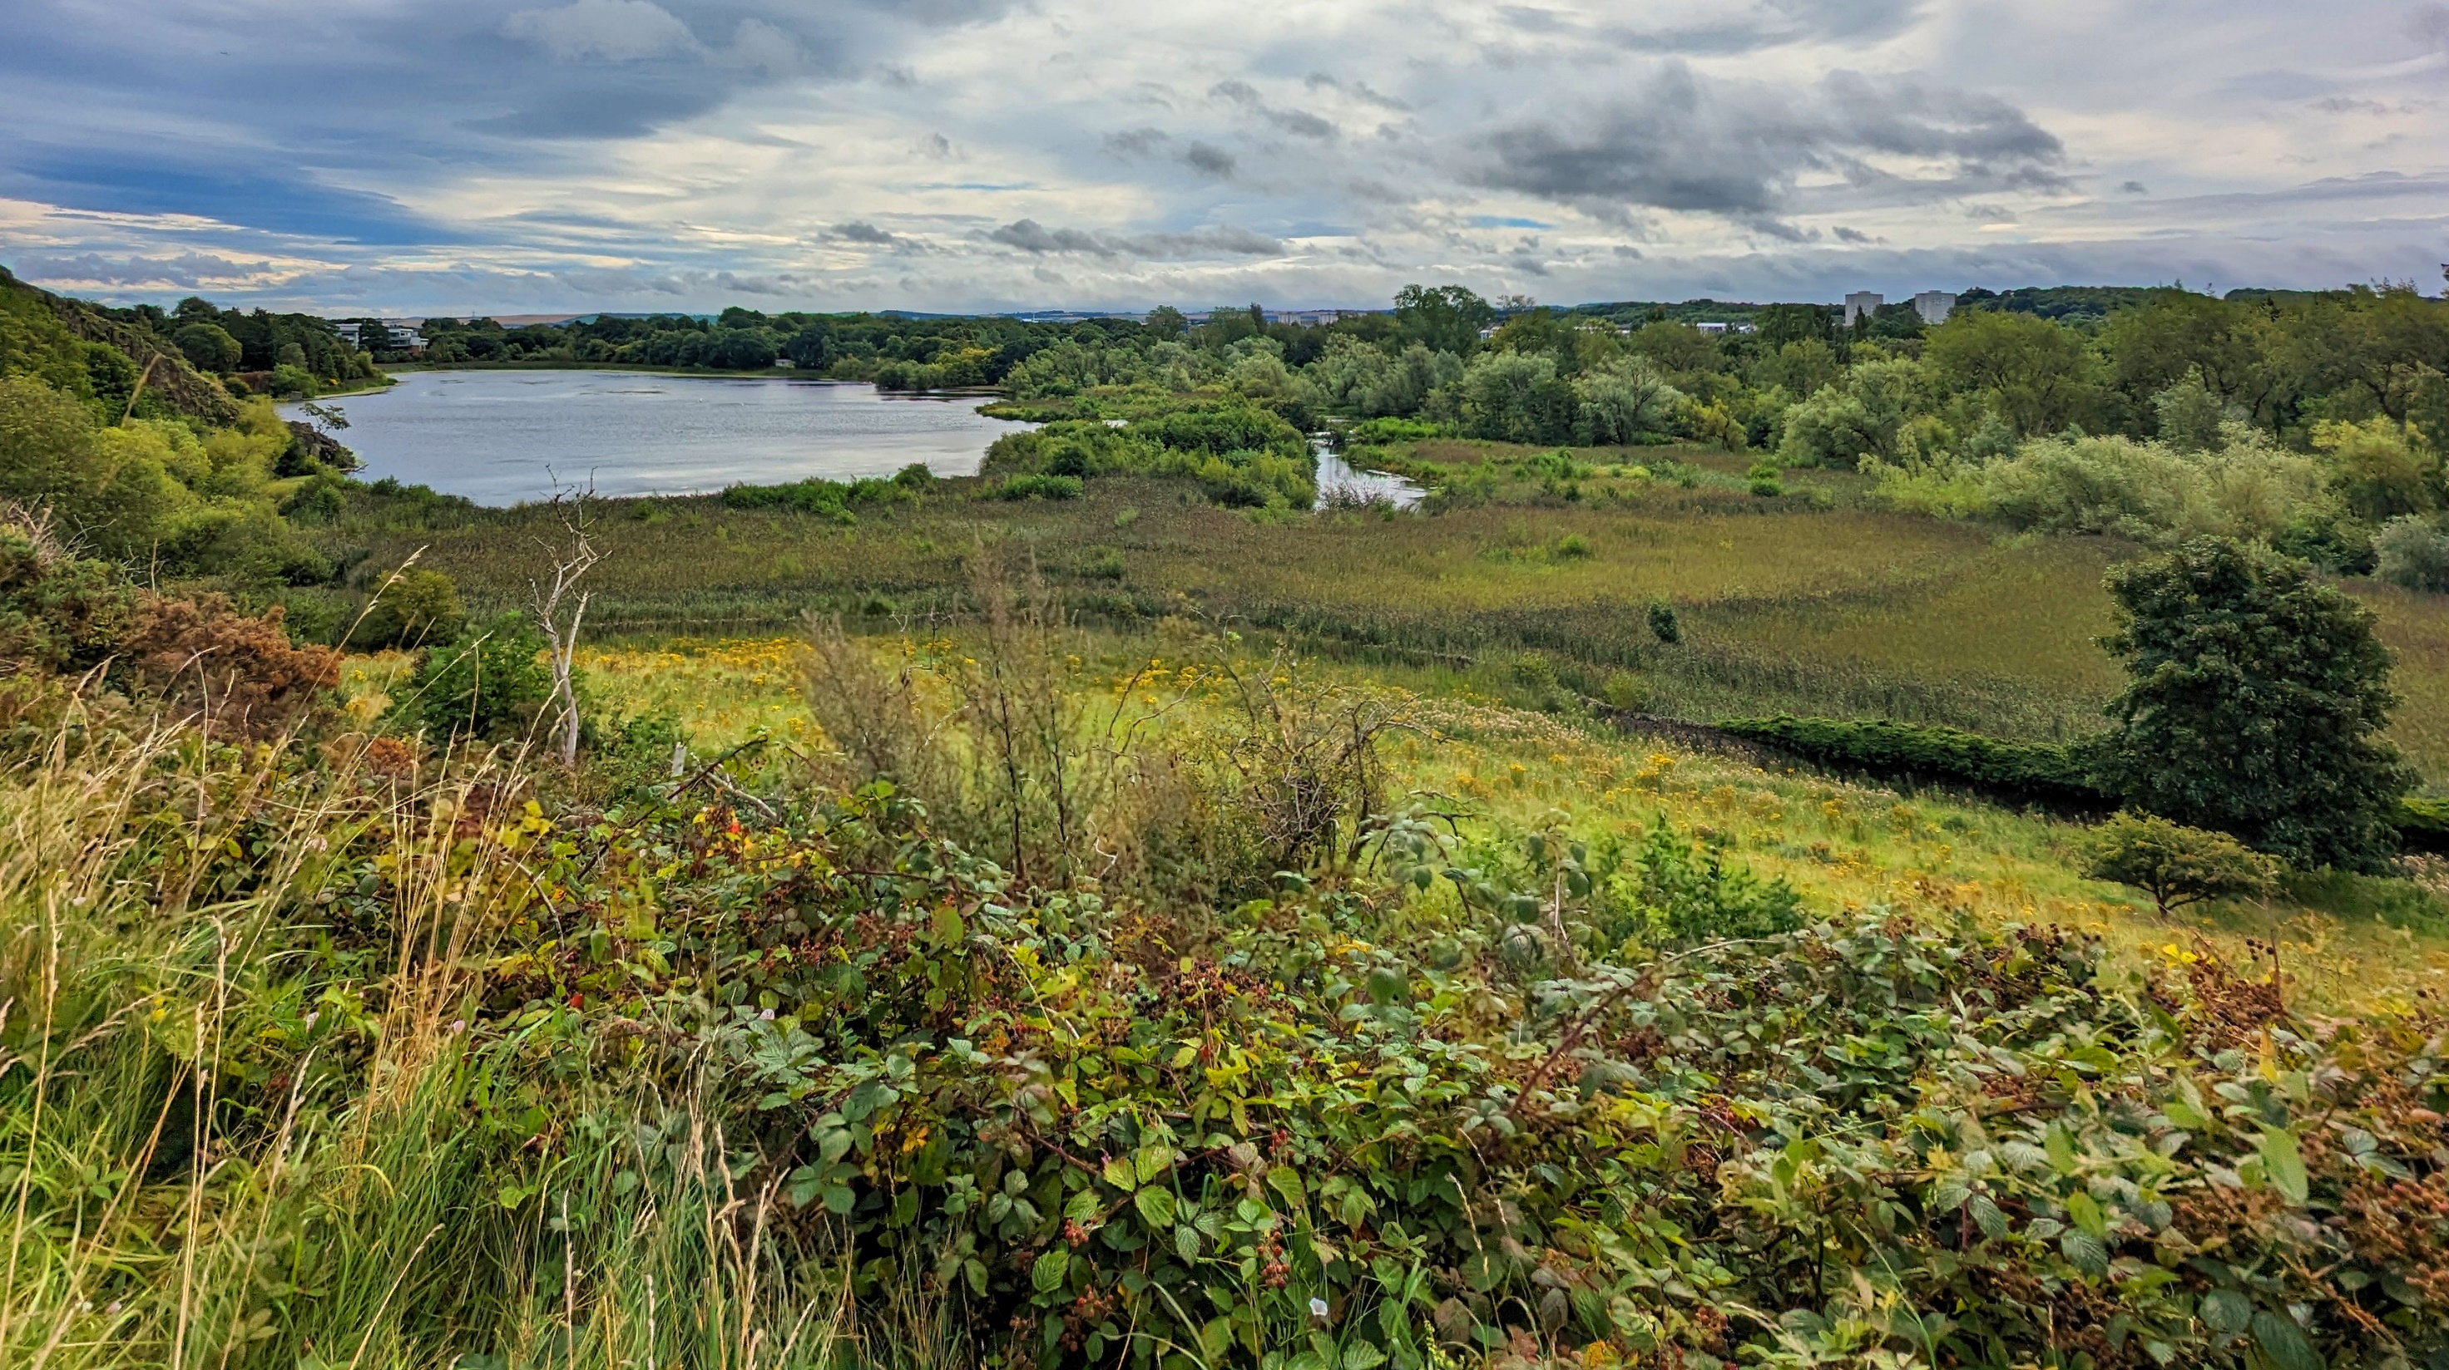
Can you divide this image into different habitats?

Slide 4
What factors did you use to differentiate habitats?
plants
water
elevation
animals

Slide 5
We can divide these factors into two groups
Biotic factors
plants
animals
Living components of an ecosystem.
Abiotic factors
water
elevation
Non-living components of an ecosystem.

Slide 6
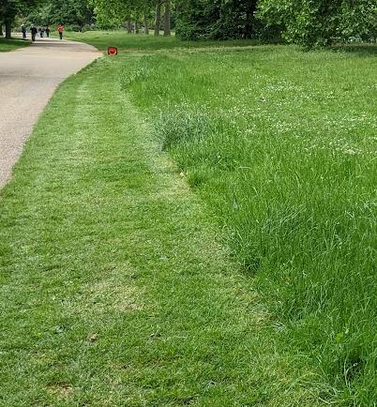
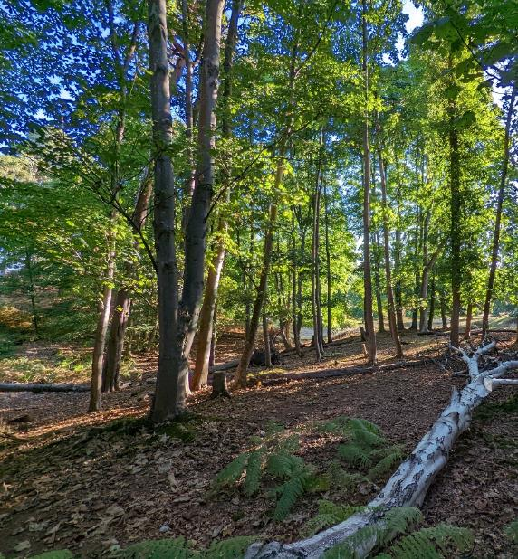
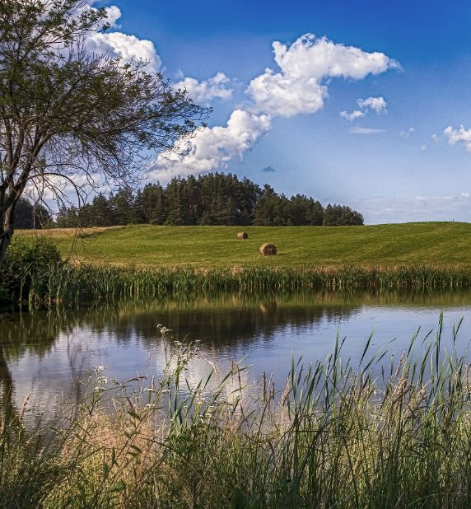
What might be some abiotic differences between these common habitat types?
Grasslands
Woodlands
Wetlands
Notes:
A few possible responses
Soil composition – Clay soils and organic matter can both retain more moisture than sandy soils, in some cases enough to allow wetland habitats to form.
Elevation – Wetlands tend to form in low-lying areas where water collects. Trees are not able to grow at high elevations because of increased wind, and low moisture and temperatures.

Slide 7
What might be some abiotic differences between these common habitat types?
Drier
Wetter
Notes:
Grasslands are dominated by grasses, woodlands by trees, wetlands by aquatic plants. This biotic difference is partly driven by water availability.
Grasslands predominate in places with lower rainfall. Trees require more water, with broadleaved trees usually requiring even more water.
However, when soils get very wet, this can reduce oxygen availability for roots, causing many terrestrial plants to drown.

Slide 8
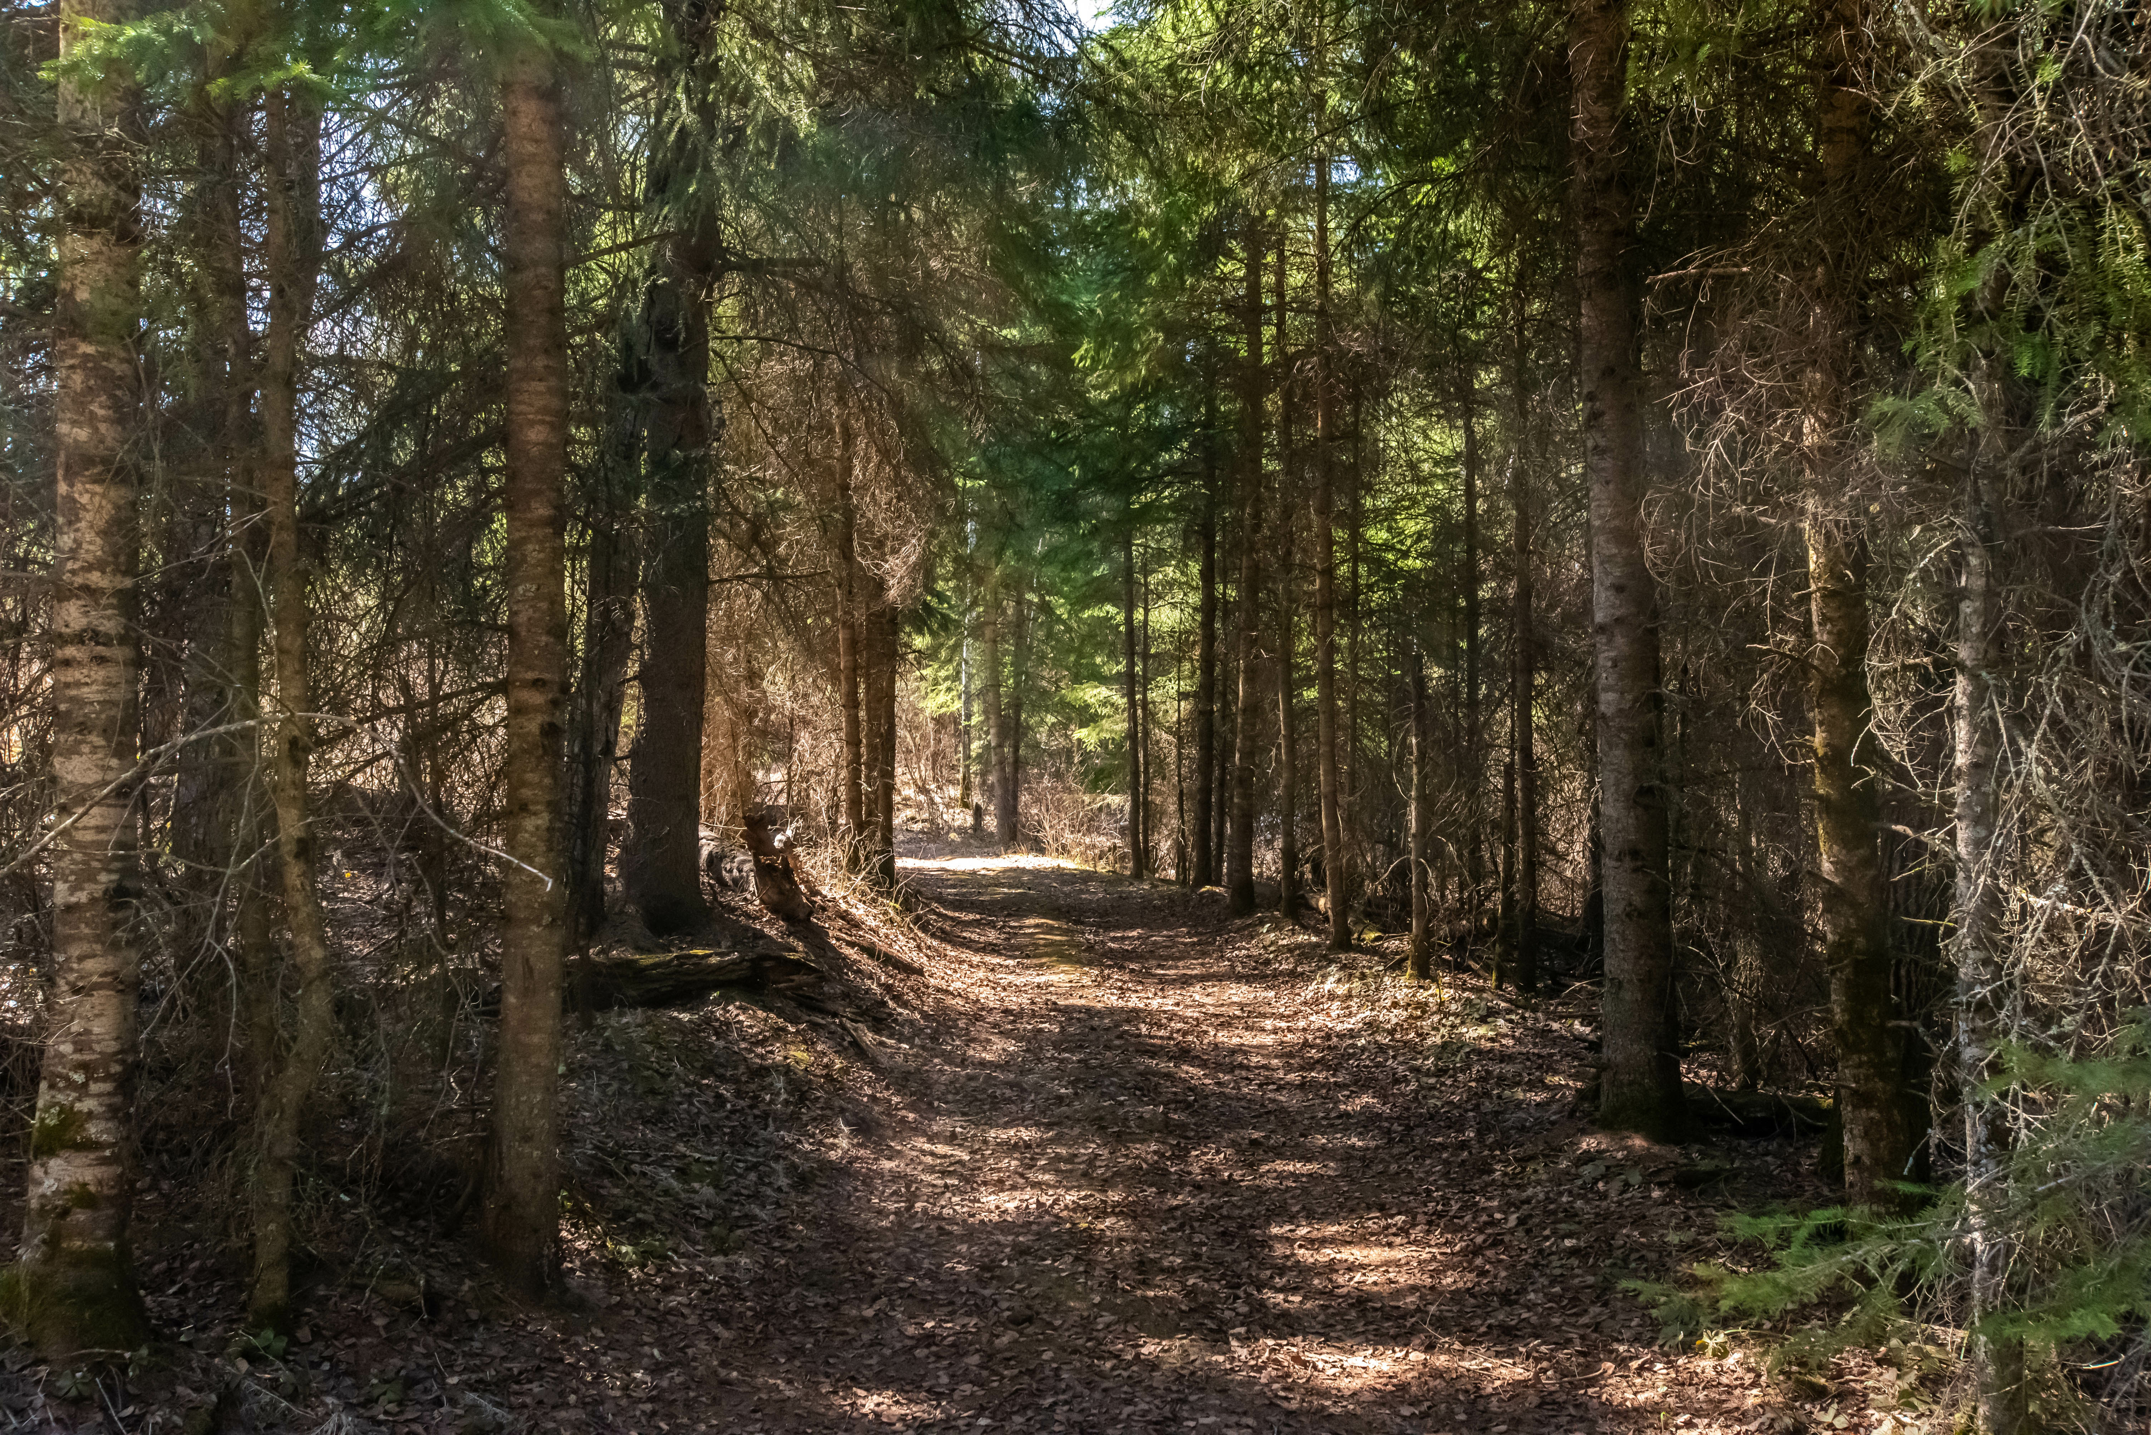
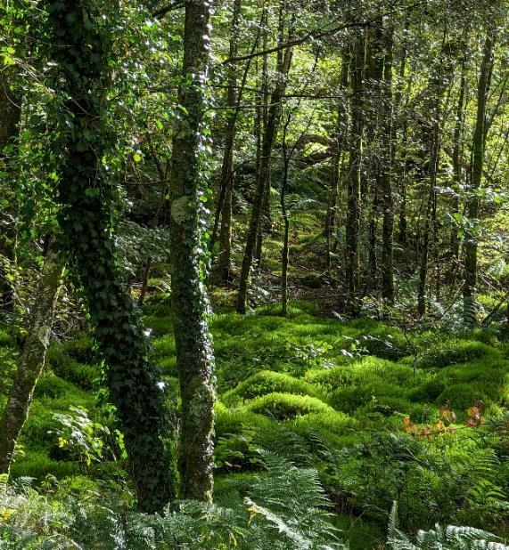
We can divide these habitats into more specific types, each with specialised biotic communities.
Evergreen
Broadleaved
Temperate rainforest
Notes:
Evergreen woodlands have mostly evergreen trees such as pine or spruce. These habitats tend to form in areas that get less rain and have colder, snowier winters.
Broadleaved woodlands have mostly broadleaved or deciduous trees such as oak or maple. These habitats tend to form in areas that get a bit more rain, and have warmer winters with less snow.
Temperate rainforests are woodlands that get much more rain. The trees are usually deciduous, and they are often covered in mosses and liverworts. These are special types of plants that grow very well in wet places. In addition to more rain, these habitats form in areas with mild winters and lots of humidity.

Slide 9
Researching and matching
Research the animal communities and match each community with their habitat.
How do the abiotic factors or other biotic factors affect the animals in each community?

Slide 10
Apply concepts to our local area
Look up the animal communities on iNaturalist.
Is there enough information to suggest what habitats might be in our local area?
What can we determine about the likely abiotic characteristics of the area around our school?

Slide 11
What can we predict about the ecosystems in these habitats?
Duddingston Loch, Edinburgh
Notes:
A few possible responses
Broadleaved deciduous trees (which tend to have rounder canopies as seen here) suggest the area has milder winters, or there would be more evergreen trees (which tend to have pointier canopies, like Christmas trees).
Woodland on the slope has different trees from the woodland near the pond/lake. In this case the lighter coloured/silvery trees are willows, which grow well in wet conditions where other trees’ roots will drown.
Stream flowing into the lake. The ecosystem is likely to be different because of the flowing, shallower water.
Change in grassland vegetation between the foreground and background, suggesting there is something different about the soil. We cannot tell In this case, the darker grassland towards the background is likely mainly reeds, rushes, and other plants which thrive in wet conditions.
The hedge in the foreground will likely be home to animals which need dense vegetation It looks like it is mainly bramble, which produces blackberries, providing food for birds and mammals. It looks relatively narrow and runs in a line, suggesting it’s likely it was planted by humans (biotic factor), rather than naturally occurring because of abiotic factors.

Slide 12
Reflection
How can understanding the biotic and abiotic factors in the surrounding area help with deciding what enhancements we would like to make to our site?

Slide 13
Next steps

Slide 14
Profile our local ecosystem
What are the abiotic characteristics of the area?
For example:
  What is the soil pH?
  How quickly does the soil drain?
What is the biotic community?
For example:
  Which plants and trees grow in the area?
  What specialist animals live in the area?

Slide 15
Habitat profiles

Slide 16

Evergreen woodland

Slide 17
Evergreen woodland
Significant abiotic factors
enough soil moisture to support trees
freezing winters often with heavier snowfall
Plant community:
evergreen or coniferous trees
In the UK, many evergreen woodlands were planted by humans as timber plantations.

Slide 18
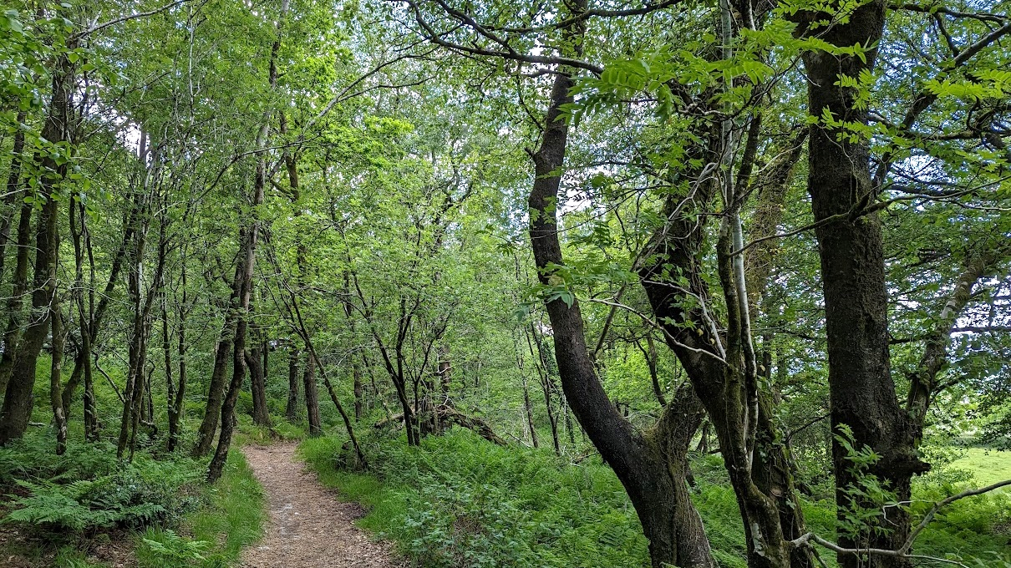
Deciduous woodland

Slide 19
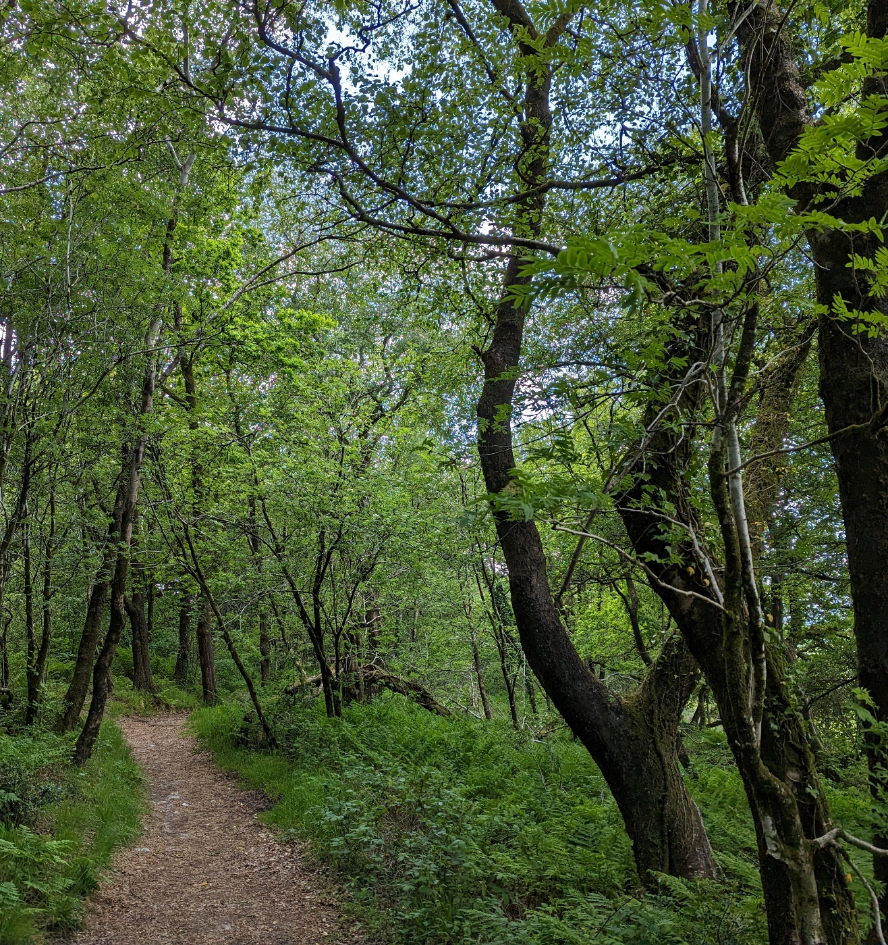
Deciduous woodland
Significant abiotic factors
enough soil moisture to support trees
mild winters with less snow accumulation
Plant community:
broadleaved trees, spring flowers

Slide 20
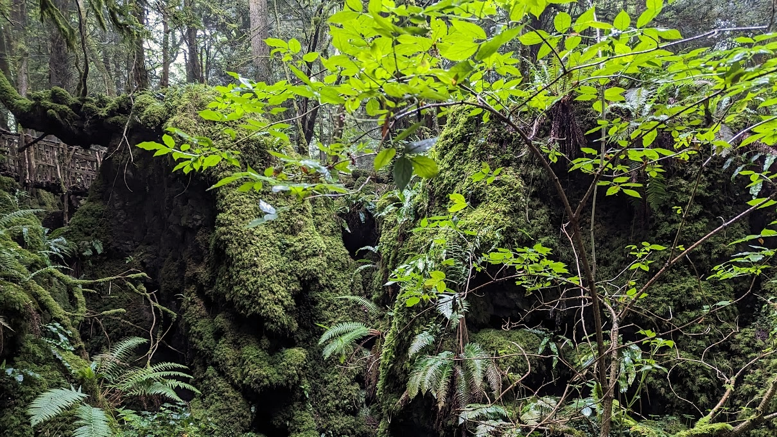
Temperate rainforest

Slide 21
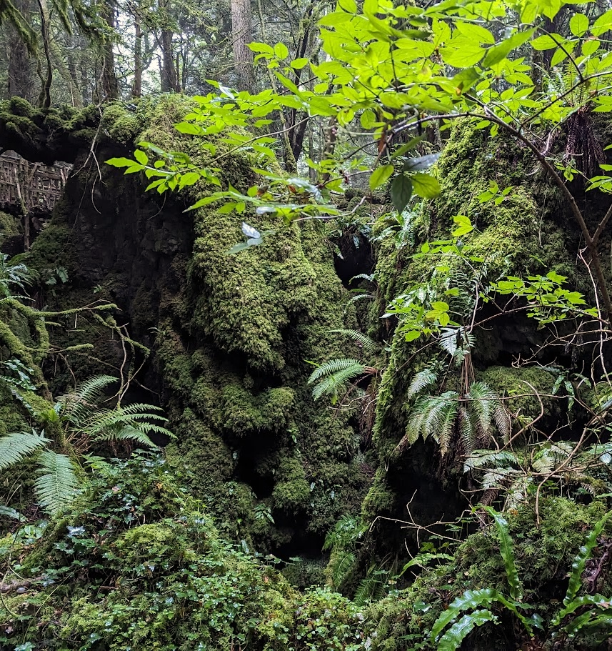
Temperate rainforest
Significant abiotic factors
high rainfall and humidity
mild winters and cool summers
Plant community:
mixed woodland
high moss diversity covering the ground and trees

Slide 22
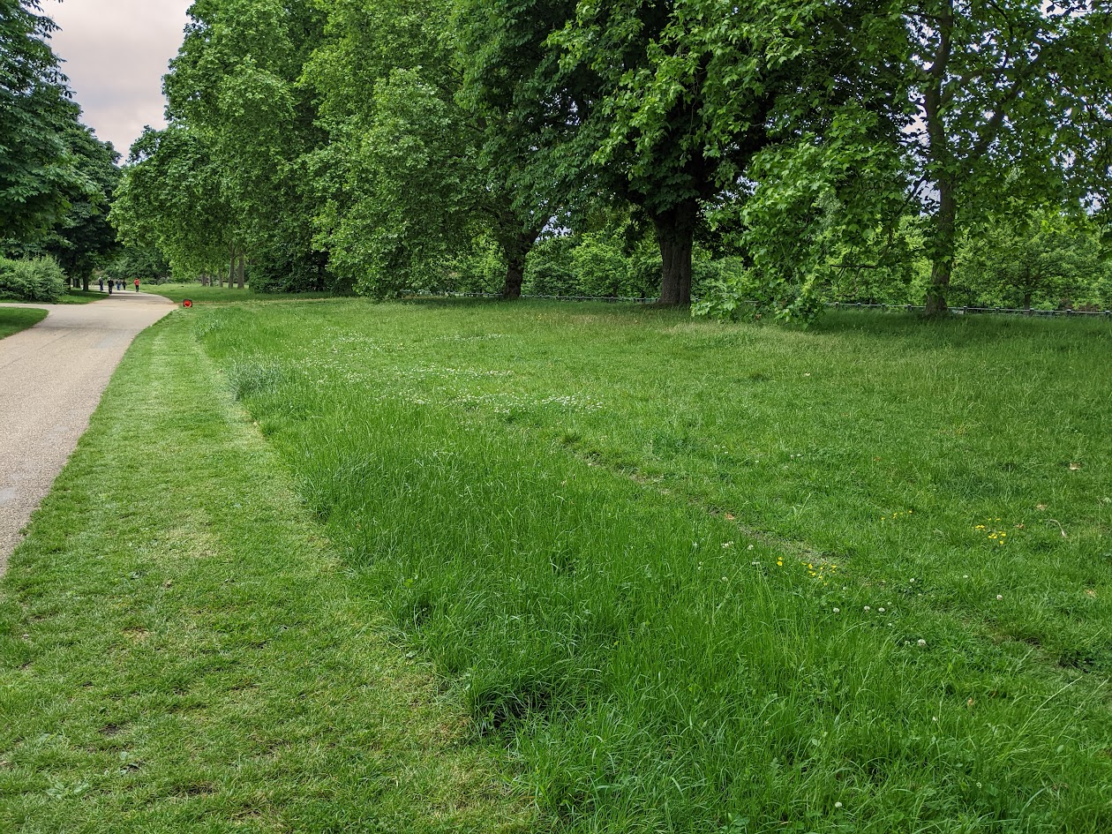
Lawn

Slide 23
Lawn
Significant abiotic factors
any soil structure or chemistry
any climate
Plant community
annual meadowgrass, dandelion, plantains, clovers

Slide 24
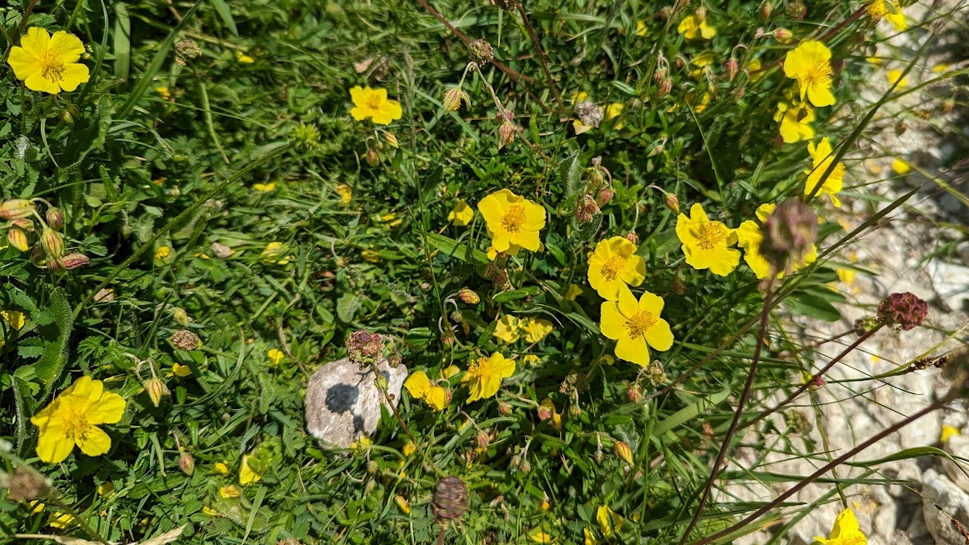
Calcareous grassland

Slide 25
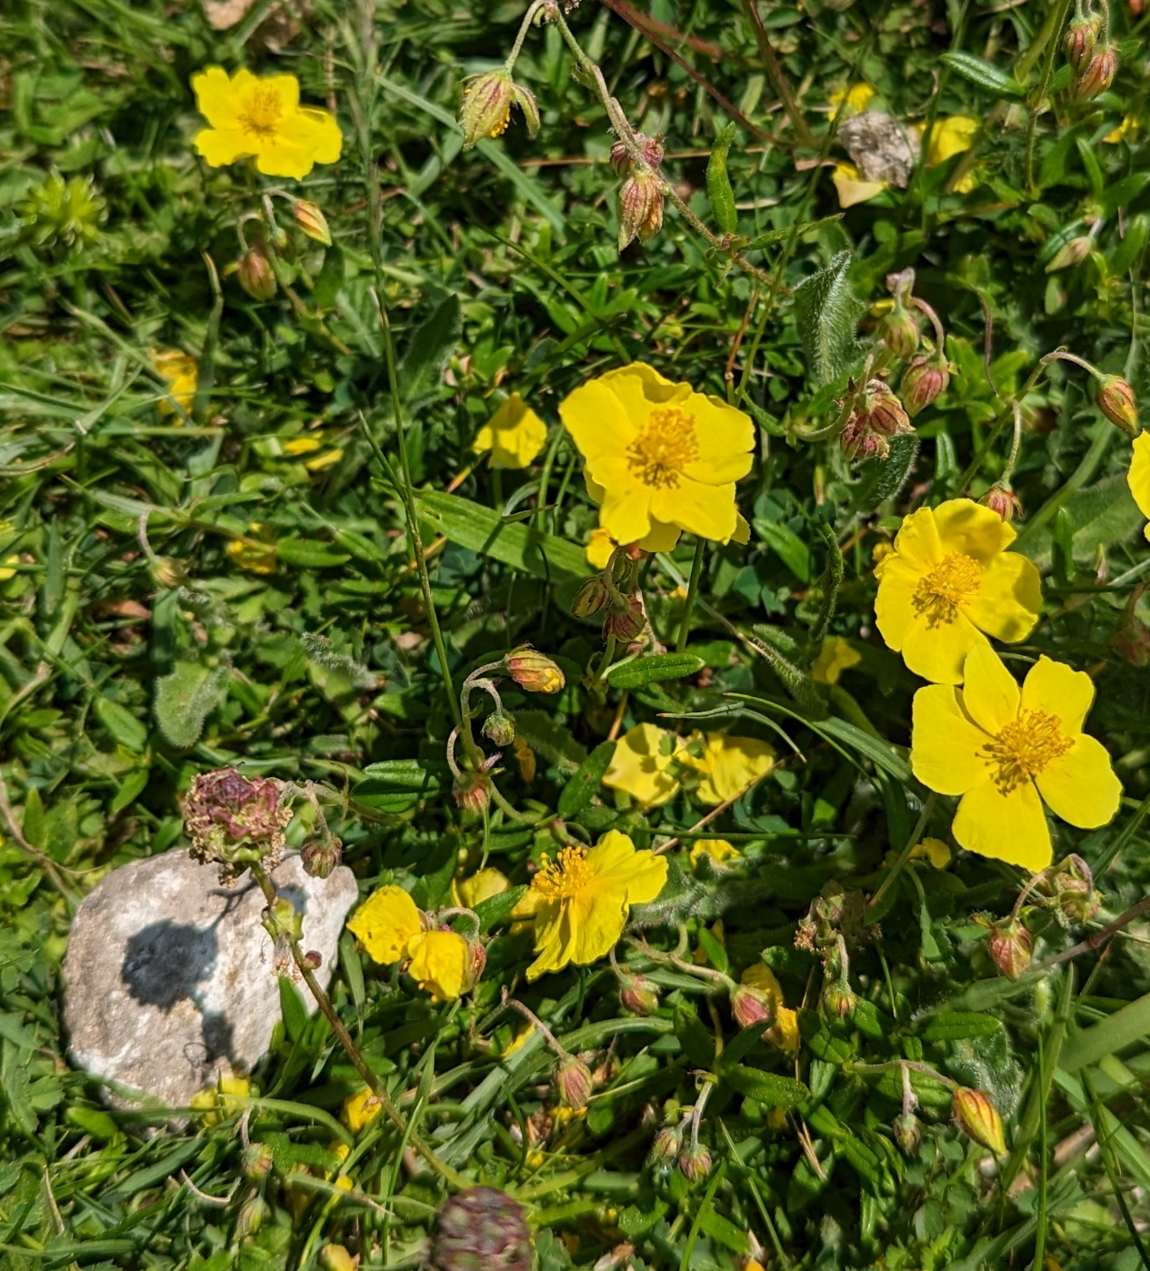
Calcareous grassland
Significant abiotic factors
high soil pH
soil often formed on chalk or limestone
Plant community
grasses, salad burnet, cinquefoils, horseshoe vetch

Slide 26
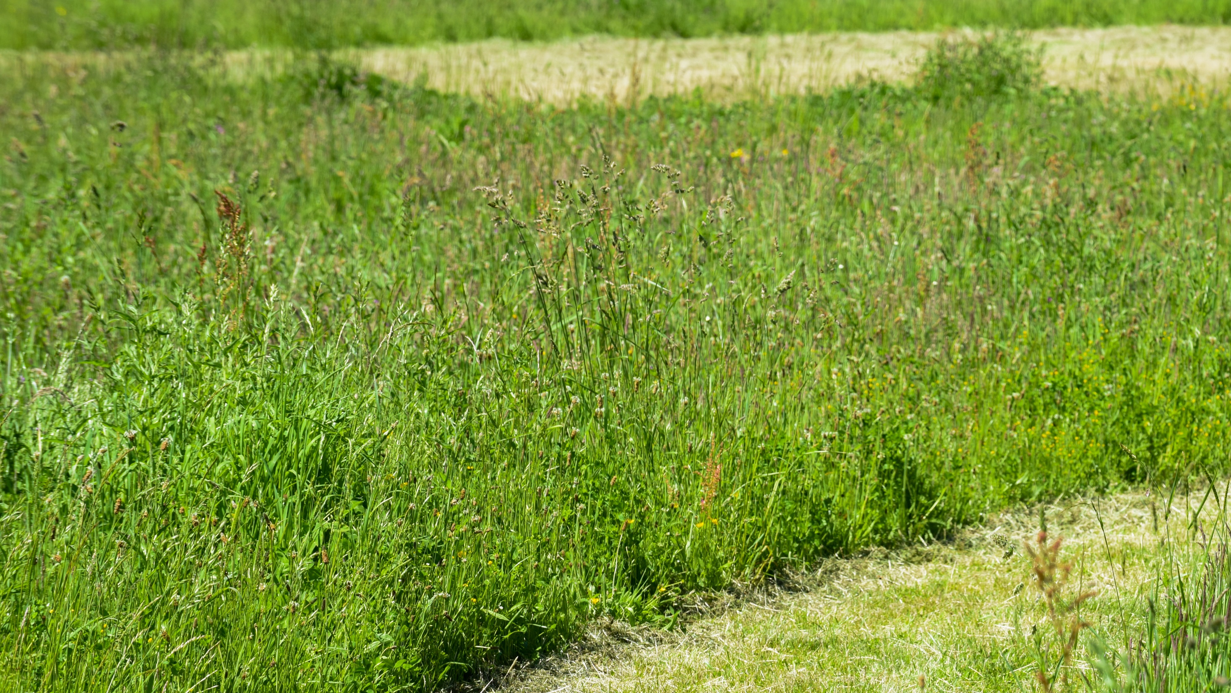
Acid grassland

Slide 27
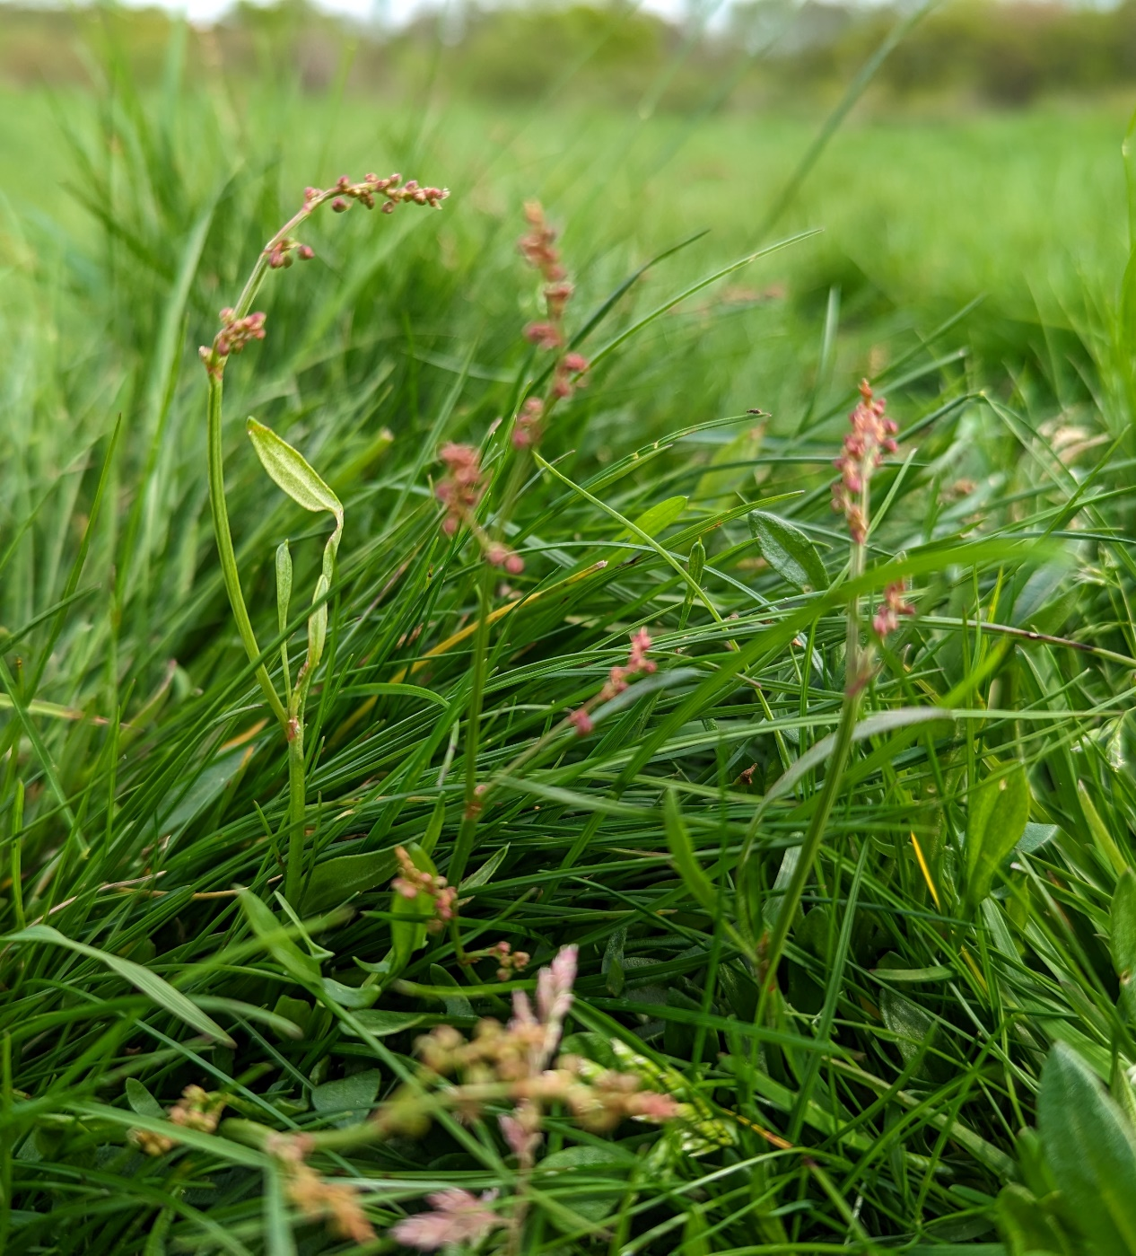
Acid grassland
Significant abiotic factors
low soil pH
soil often formed on granite or other insoluble rocks
Plant community
grasses, sheep sorrel, clovers

Slide 28
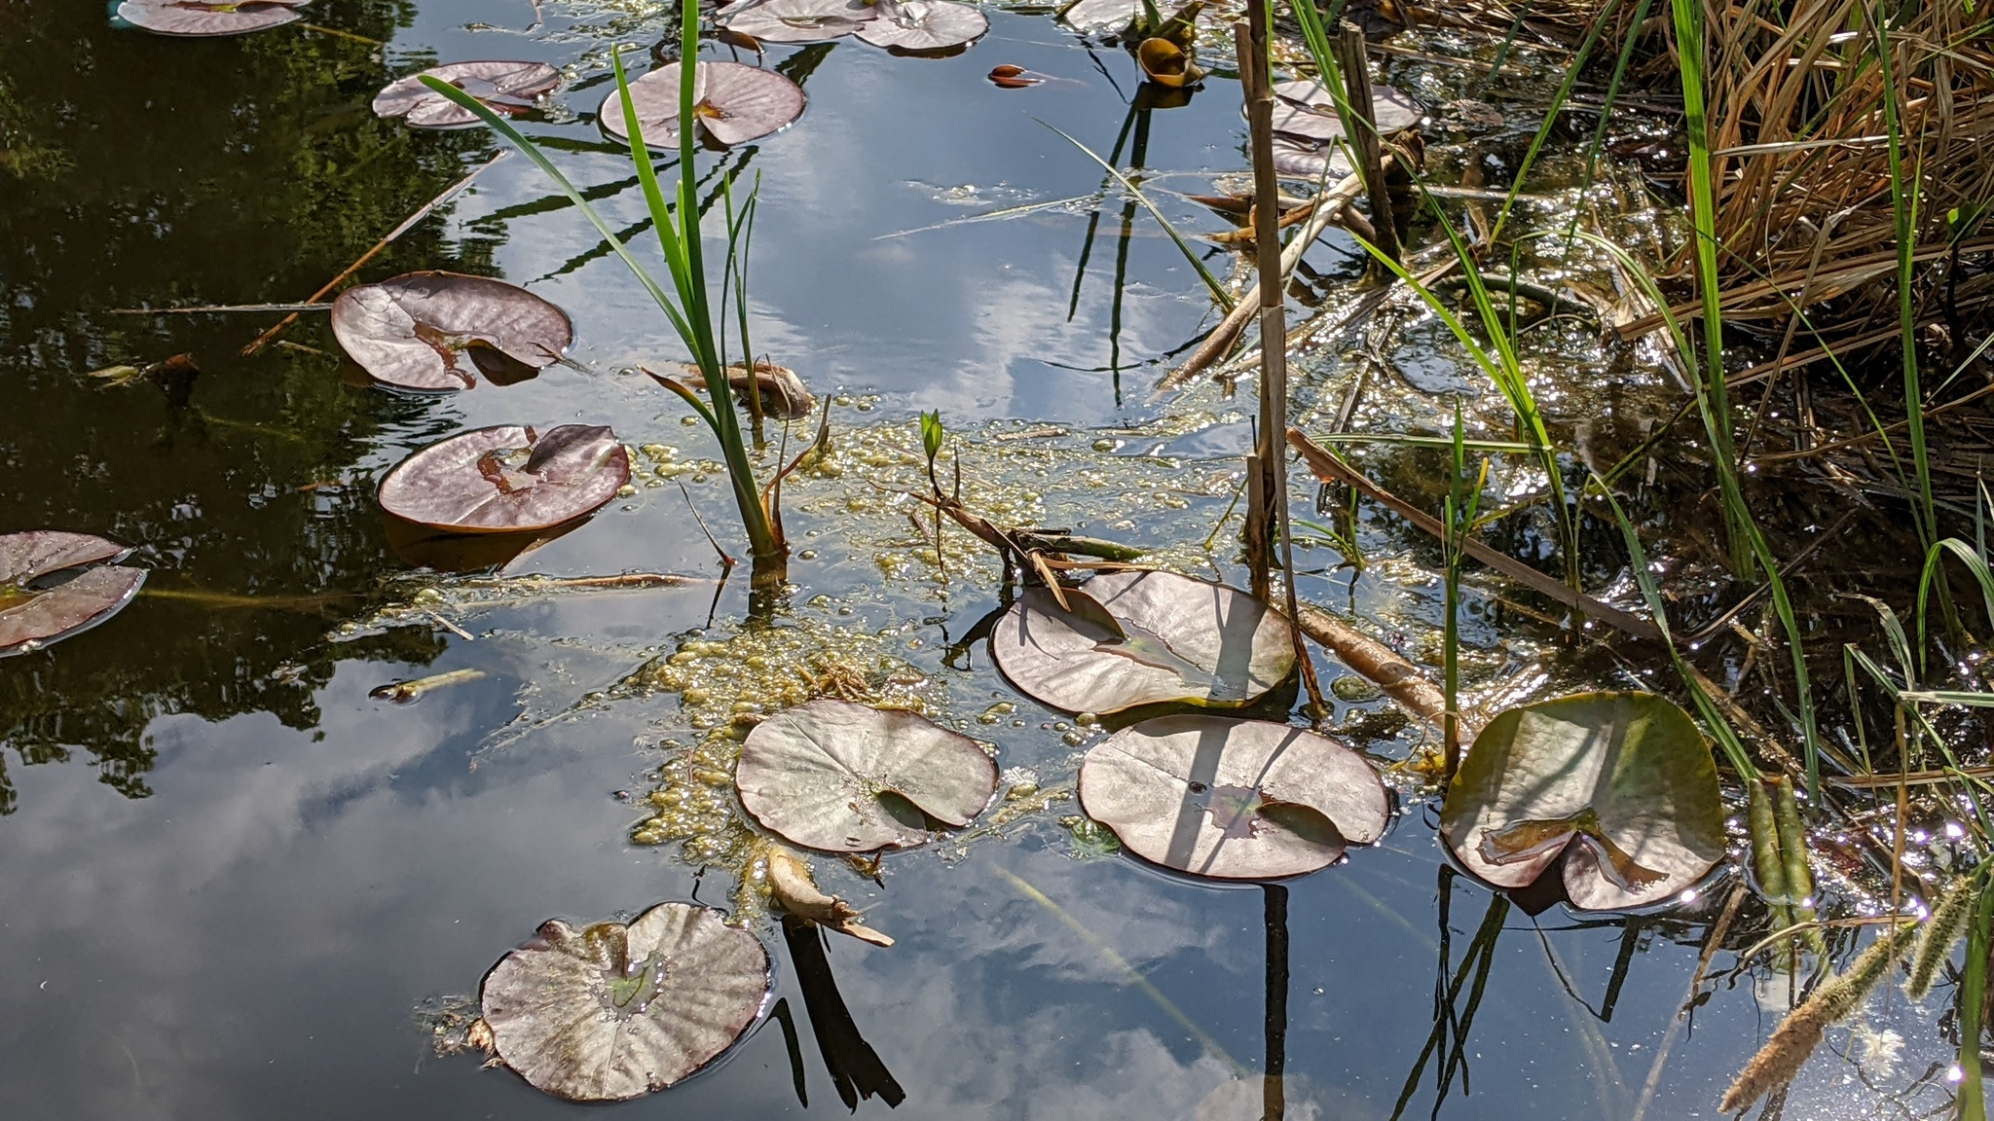
Pond

Slide 29
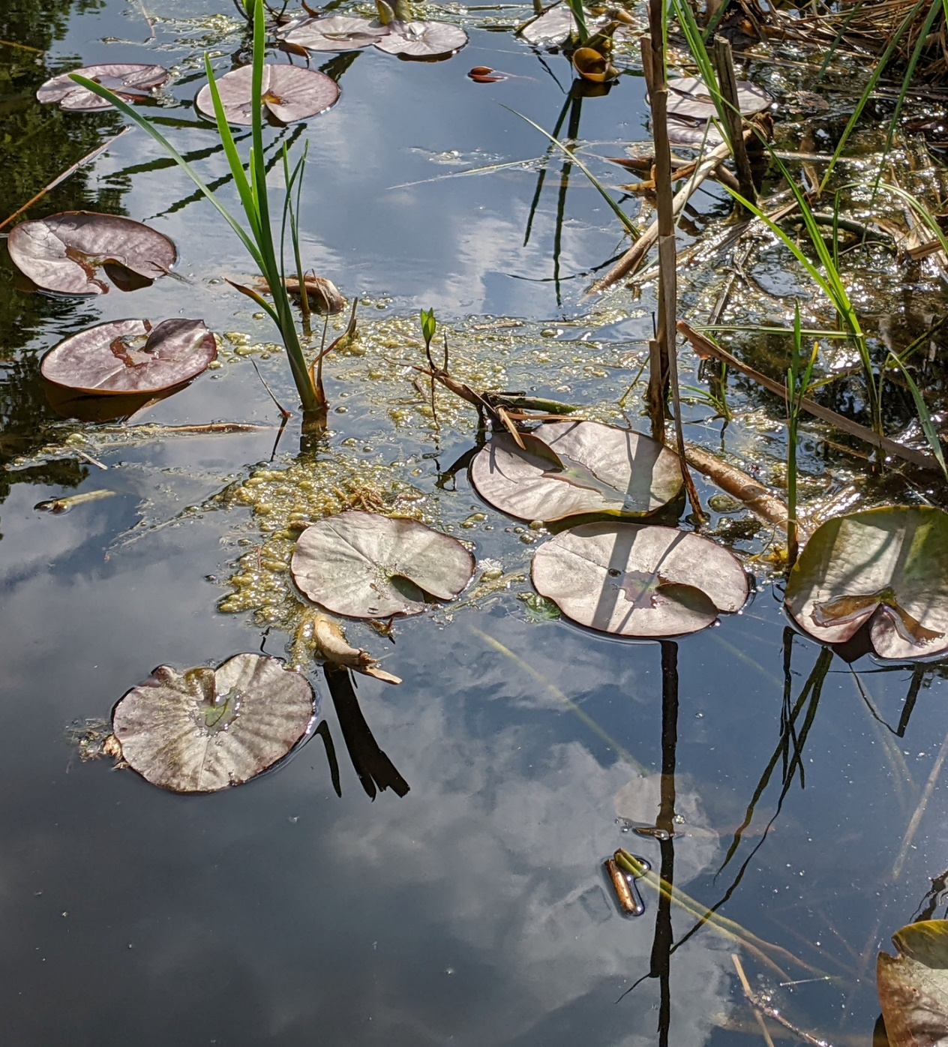
Pond
Significant abiotic factors
Standing water
Water usually fresh, occasionally brackish
Plant community
Reeds, Pond Weeds, Duckweeds

Slide 30
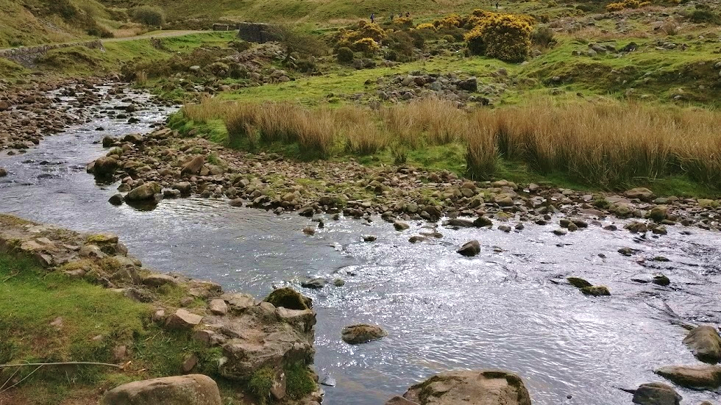
Stream

Slide 31
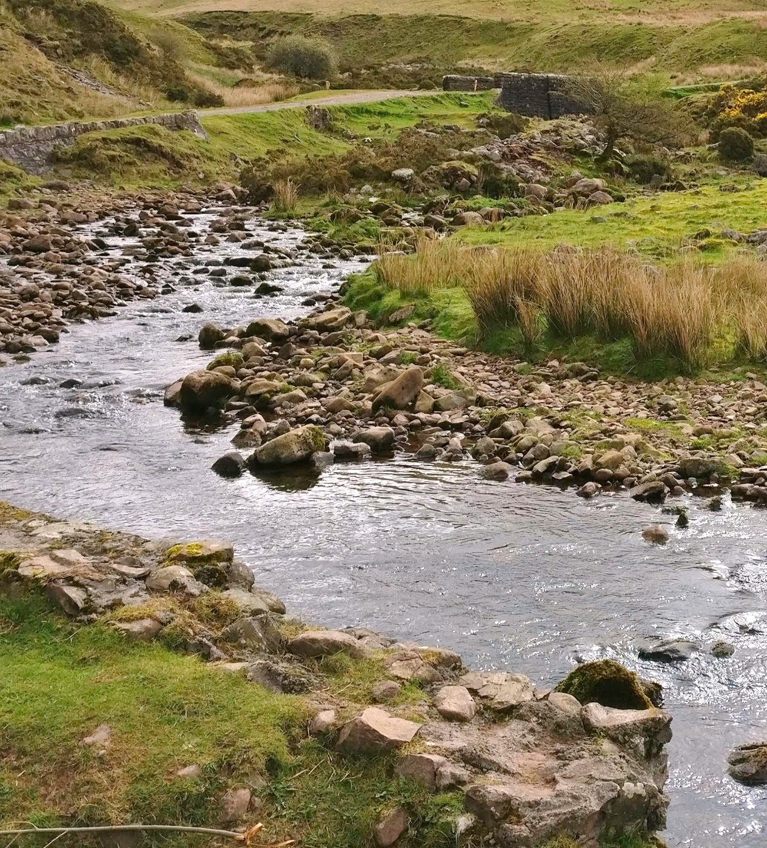
Stream
Significant abiotic factors
Flowing water
Water usually shallow and fordable (able to be crossed on foot)
Plant community
Long-beaked Water Feather-moss, algae, reeds

Slide 32
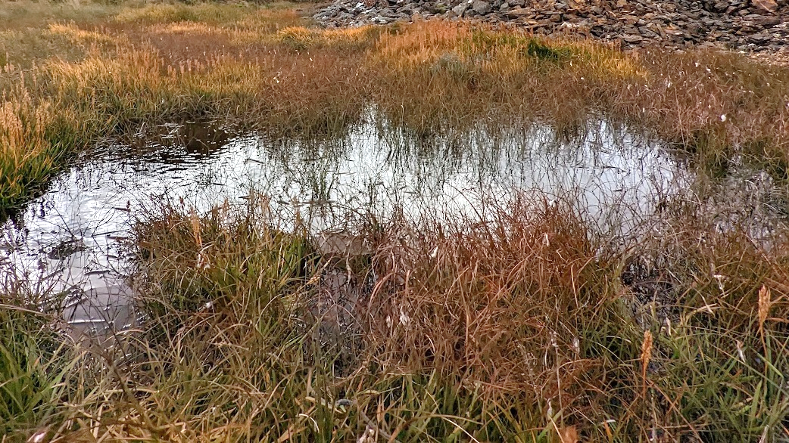
Bog

Slide 33
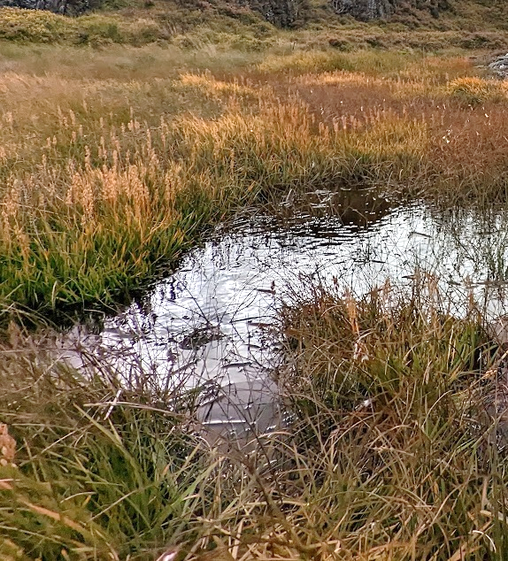
Bog
Significant abiotic factors
waterlogged soil or shallow standing water
anoxic and acidic water or soil
Plant community
sphagnum mosses, cotton grasses, butterworts, sundews

Slide 34
Animal communities

Slide 35
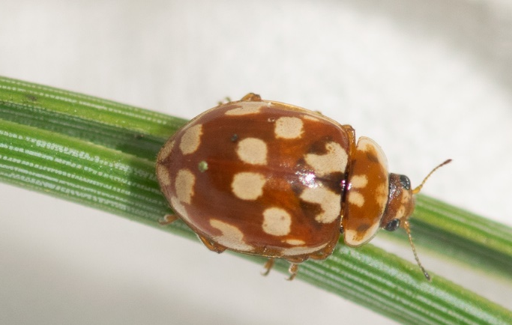
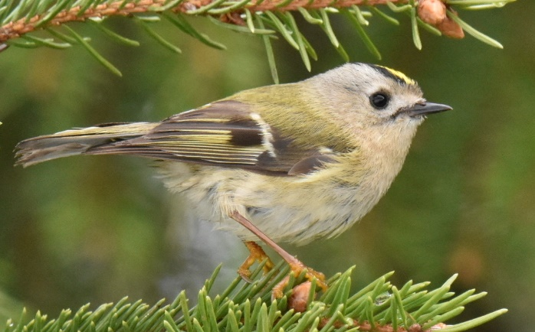
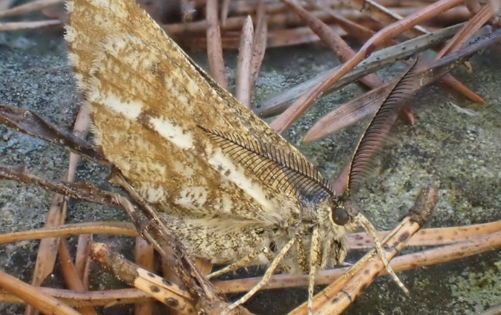
Animal community 1
Goldcrest
(Regulus regulus)
18-spotted ladybird
(Myrrha octodecimguttata)
Bordered white moth
(Bupalus piniaria)
Photo by Лариса Артемьева. From iNaturalist. CC0
Photo by Victor Heng. From iNaturalist. CC0
Photo by Thomas Hirsch. From iNaturalist. CC0
Notes:
This community specialises in evergreen woodland.
Many insects which feed on pines and their relatives are specialists. Pine needles have very different structures from the leaves of deciduous trees and often have very different chemical defences.
Goldcrests specialise in feeding on spiders and small insects sheltering between pine needles.
18-spotted ladybirds specialise in feeding on insects which feed on pine trees
Bordered white moth caterpillars feed on pine needles.

Slide 36
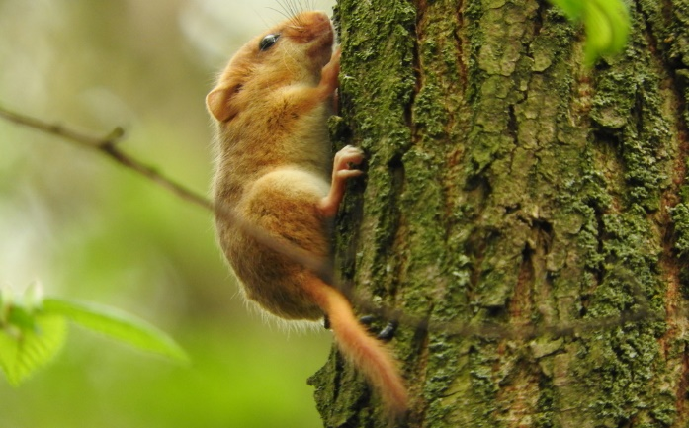
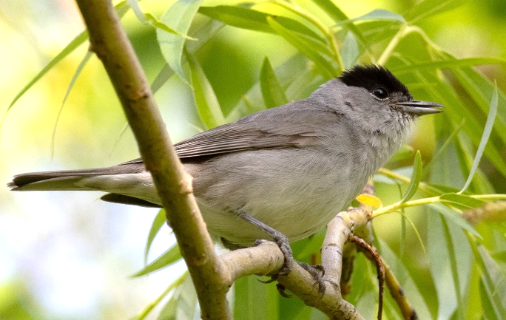
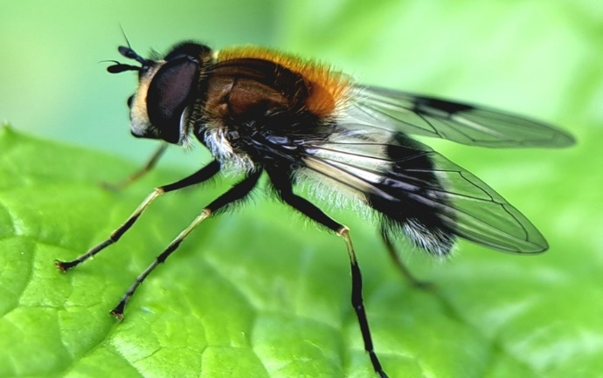
Animal community 2
Hazel dormouse
(Muscardinus avellanarius)
Blackcap
(Sylvia atricapilla)
Blotch-winged whitebelt
(Leucozona lucorum)
Photo by Francesco Cecere. From iNaturalist. CC0
Photo by Victor Heng. From iNaturalist. CC0
Photo by Jessica Alvey. From iNaturalist. CC0
Notes:
This community specialises in deciduous woodland.
Many of these specialists depend on the seasonal cycle of deciduous trees. These trees lose their leaves over winter, allowing sunlight to reach the forest floor as the weather warms in Spring. Many plants take advantage of this short window for growth. This early plant growth also supports many herbivorous insects.
Hazel dormice eat nuts, seeds, fruit, and flowers, all of which tend to be more plentiful in deciduous woodland. They also rarely move about on the ground, so they require habitats where tree canopies or shrubs allow them to move about from branch to branch.
Blackcaps have a varied diet across the year but need areas of dense undergrowth for nesting.
Blotch-winged Whitebelt is a species of hoverfly found mainly early in the year. Their larvae eat aphids and other insects which feed on spring flowers.

Slide 37
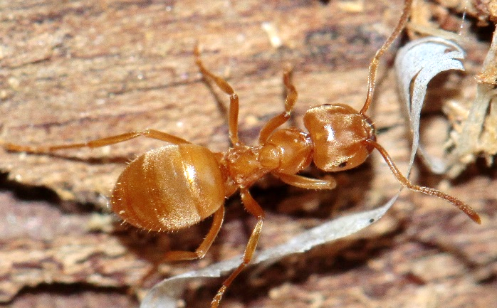
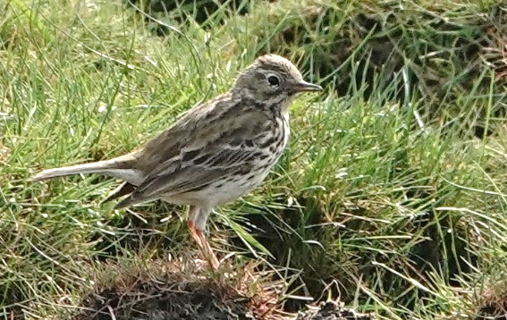
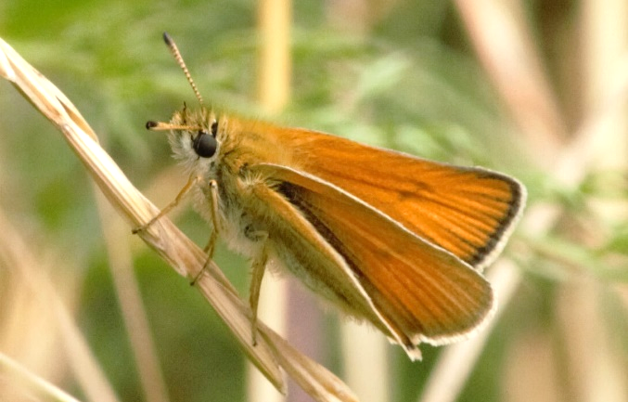
Animal community 3
Yellow meadow ant
(Lasius flavus)
Meadow pipit
(Anthus pratensis)
Essex skipper
(Thymelicus lineola)
Photo by Иван Пристрем. From iNaturalist. CC0
Photo by Margit Kildevang. From iNaturalist. CC0
Photo by Victor Heng. From iNaturalist. CC0
Notes:
This community specialises in acid grassland.
These often have sandy soils where water leaches calcium ions deeper into the ground, leaving the surface soils more acidic. They also often form over less soluble rocks, which have less calcium to dissolve and become available to plants and other organisms.
Yellow meadow ants have long-lived colonies which build large anthills. However, in areas which are not well-drained or prone to flooding, colonies can quickly drown.
Meadow pipets feed on a variety of invertebrates and build their nests on the ground, sheltered by vegetation. Mixed vegetation types and heights provided by anthills can help with nesting sites and food availability.
Essex skipper caterpillars feed on a variety of grasses which grow in dry grassland habitats.

Slide 38
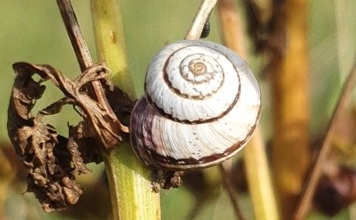
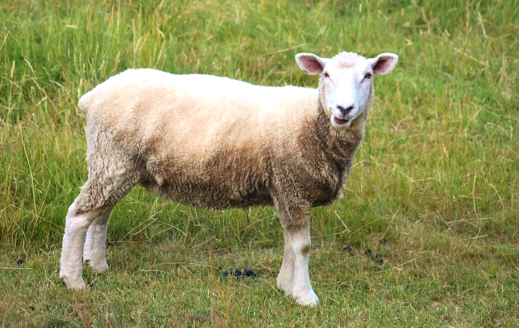
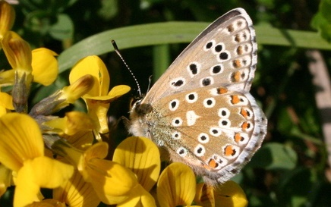
Animal community 4
Striped snail
(Cernuella virgata)
Sheep
(Ovis aries)
Adonis blue butterfly
(Polyommatus bellargus)
Photo by Ben Mapp. From iNaturalist. CC0
Photo by Jason Leduc. From iNaturalist. CC0
Photo by Richard Fuller. From iNaturalist. CC0
Notes:
This community specialises in calcareous grassland.
These grasslands form on top of chalk. Soils tend to be thin and quick-draining, but calcium and other ions are quickly replaced by the chalk in the soil. Soil chemistry and structure support a variety of specialist plants.
Striped snail is found in calcareous and coastal grasslands. Many snails benefit from the greater availability of calcium in these habitats because it is crucial for shell growth.
Sheep grazing is one of the processes that maintains these habitats, keeping the level of vegetation low. It is also thought that the removal of trees to create pasture for sheep and other livestock to graze hundreds of years ago played a role in creating these habitats in the UK.
Adonis blue butterfly is one of many butterfly species that depend on a single plant species for food. In this case, they are dependent on the horseshoe vetch, which grows in alkaline soils and is a pioneer species in areas of exposed chalk.

Slide 39
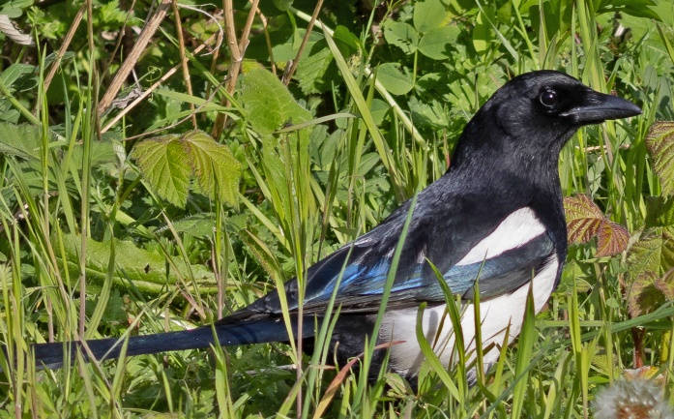
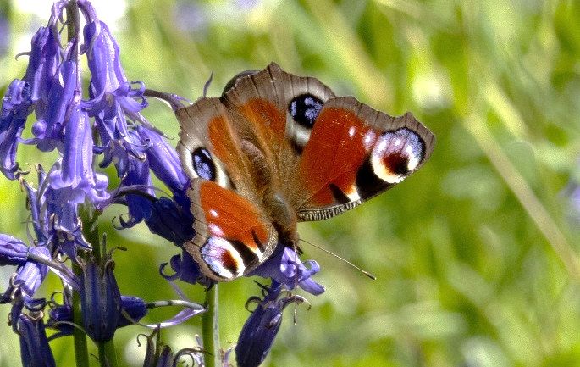
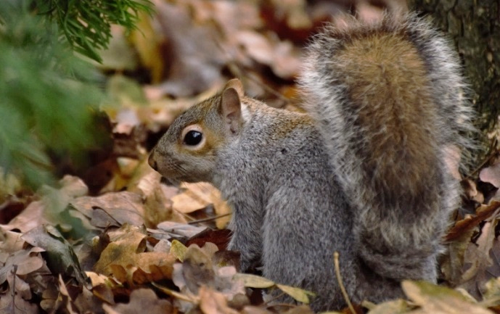
Animal community 5
Magpie
(Pica pica)
Peacock butterfly
(Aglais io)
Grey squirrel
(Sciurus carolinensis)
Photo by Victor Heng. From iNaturalist. CC0
Photo by Victor Heng. From iNaturalist. CC0
Photo by Victor Heng. From iNaturalist. CC0
Notes:
This is a generalist animal community.
Many species which are faring well in today’s changing environment are generalist species which can live in a variety of habitats, including human settlements and cities.
Magpies are generalist feeders which will eat anything, including fruit, seeds, invertebrates, and roadkill.
Packock butterfly caterpillars are dependent on common and small stinging nettle as a food plant. However, nettles are quick to grow and spread easily to newly disturbed ground.
Grey squirrels are bold and not as easily disturbed by human activity as many other species, meaning they are adaptable to human disturbance.

Slide 40
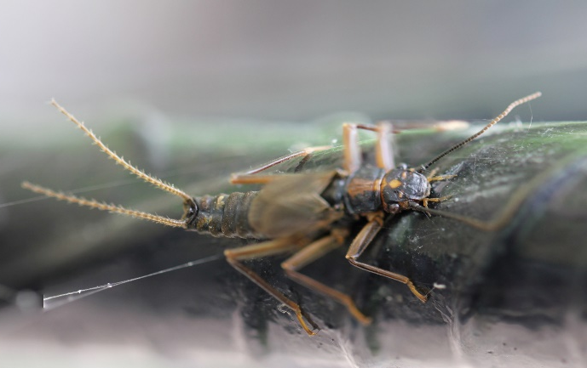
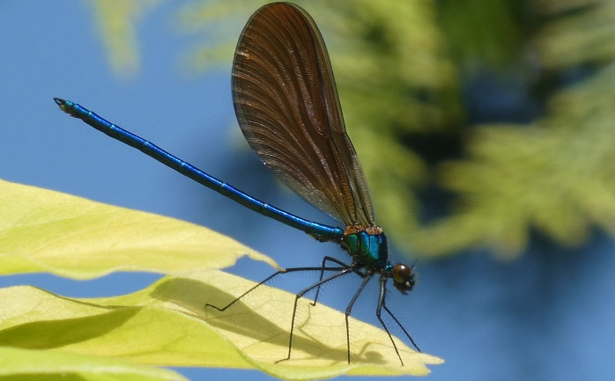
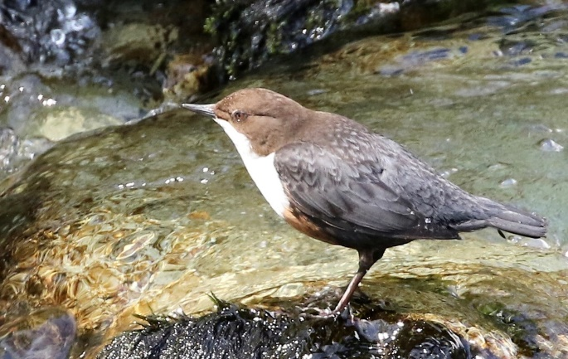
Animal community 6
Beautiful demoiselle
(Calopteryx virgo)
Dipper
(Cinclus cinclus)
Stonefly
(Diura bicaudata)
Photo by John Potter. From iNaturalist. CC0
Photo by pillarboxcottage. From iNaturalist. CC0
Photo by bulatik. From iNaturalist. CC0
Notes:
This community specialises in streams.
Many aquatic species are greatly affected by water depth and flow rate. These factors affect light and oxygen availability as well as the substrate at the bottom of the waterway. Slower-flowing waters accumulate organic matter and can be muddy. Faster flower streams tend to have sandy or rocky bottoms.
Beautiful demoiselles are a type of damselfly, cousins of dragonflies, they are associated with sandy or gravelly streams. Their cousin, the banded demoiselle, is associated with muddy streams.
Dippers specialise in feeding in fast-flowing streams, where they forage by running underwater in search of small invertebrates.
Stoneflies have larvae which are adapted to flowing water, with flattened bodies to reduce drag from water and strong legs to grip onto stones.

